Slide 1
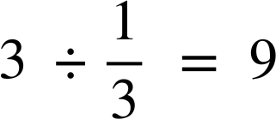
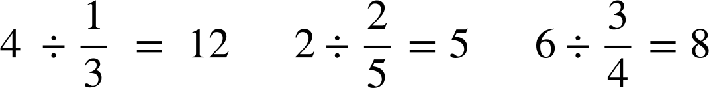
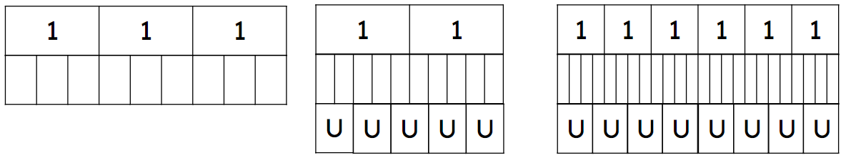
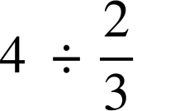
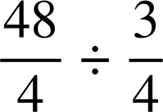

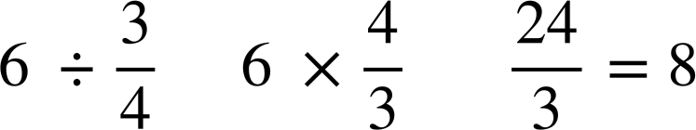
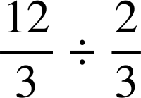
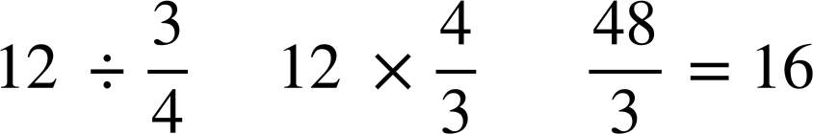
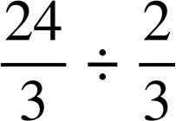
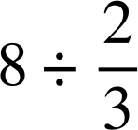
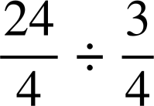
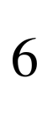
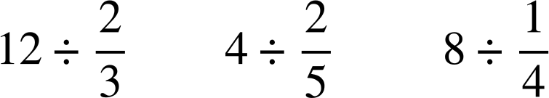
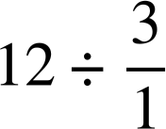
Dividing a whole number by a fraction
Task A: Making sense of dividing by a fraction
1) Use the bar models to show the division of the following.
a)
b)
c)
2) Match the question with the calculation and the answer.
3) Circle the following divisions which give an answer of four.

Slide 2
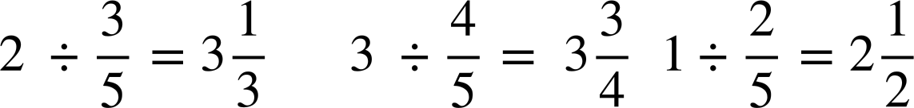
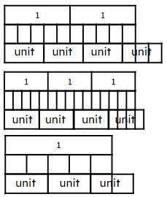
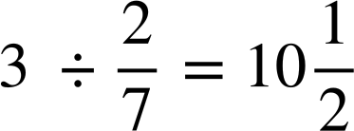

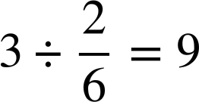
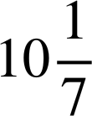


Dividing a whole number by a fraction
4) Put the following in ascending order, smallest to largest.
Task B: Deepening understanding of dividing by a fraction
1) Using the bar models, work out the answers to the following:
a)
b)
c)
2) Izzy and Laura have done the following bar models for a question
Both have made an error with their bar model.
a) Explain where they have made their mistake.
Izzy “The answer is 9”
Izzy has divided each 1 into sixths rather than sevenths.
Izzy has calculated
Laura started to correctly use a unit to be , but then incorrectly changed the unit to be .
Laura “The answer is ”

Slide 3
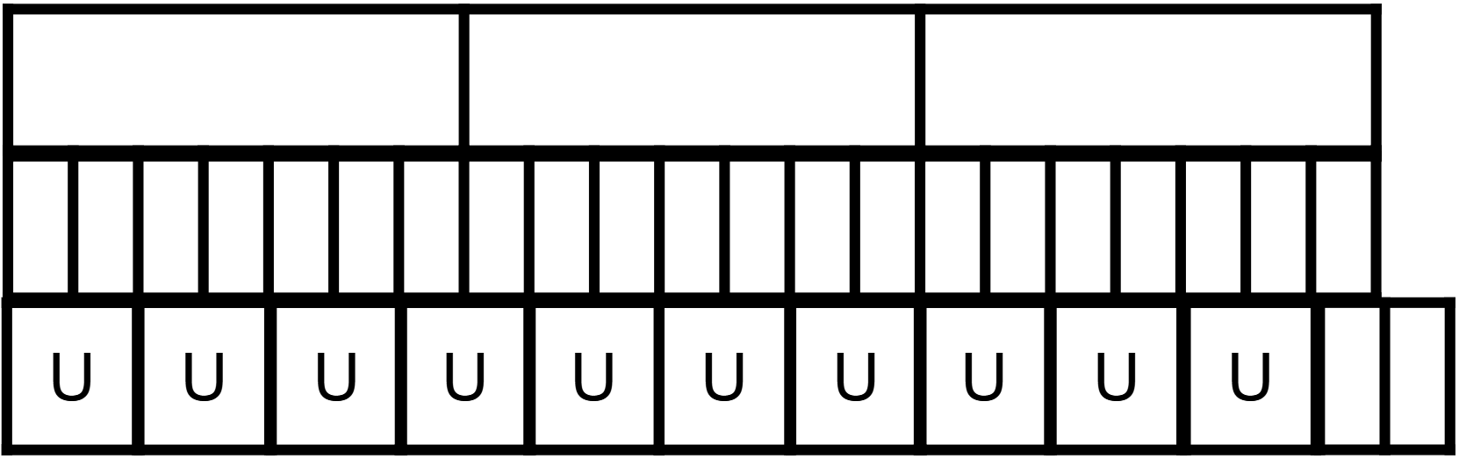
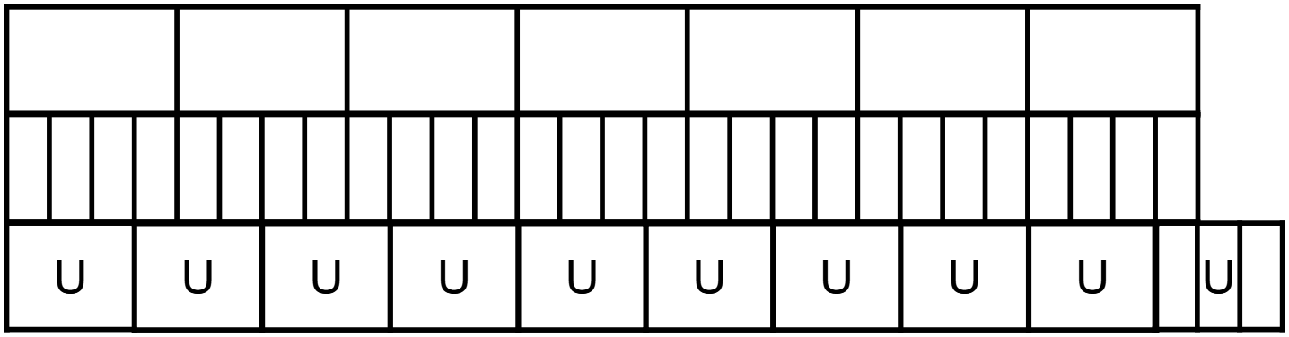
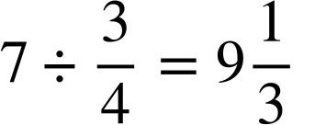
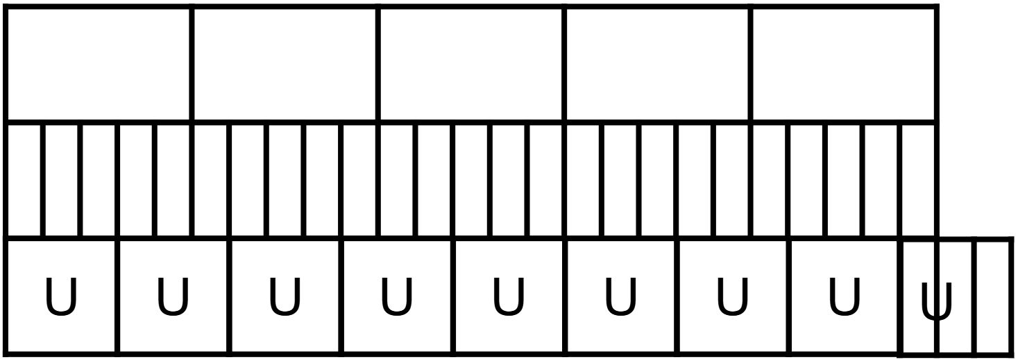
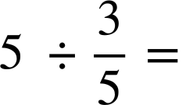
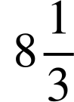
Dividing a whole number by a fraction
b) Amend a bar model to help work out the correct answer.
Changing Laura’s so there is a consistency of units, the answer is seen to be
3) Using squared paper, draw your own bar models to work out the answers to
a)
b)
c)
U
U
U
U
U
U
U
U
Mathematics in Education and Industry
v2.2

